Slide 1


Database Systems
Chapter - 06: Basic SQL
Bushra
bushra@nu.edu.pk

Slide 2
SQL - Structured Query Language
designed and implemented at IBM Research
as the interface for an experimental relational database system called SYSTEM R.
SQL is now the standard language for commercial relational DBMSs.
The standardization of SQL is a joint effort by the American National Standards Institute (ANSI) and the International Standards Organization (ISO)
SQL is a comprehensive database language
Notes:
SQL is a comprehensive database language: It has statements for data definitions, queries, and updates. Hence, it is both a DDL and a DML.
provides a higher-level declarative language interface, so the user only specifies what the result is to be, leaving the actual optimization and decisions on how to execute the query to the DBMS.
If you take the basic definition which is programming is syntax and rules for instructing a computer or computing device to perform specific tasks -SQL is definitely a programming language given this definition. But it's not! At least it is not a programming language like C or Python, so it is not a general-purpose programming language.
Thanks to SQL you can communicate with the database. It is a very powerful tool. When you write SQL queries, you give the computer instructions and the computer executes them. So that sounds pretty much like programming, right? But that's not. You cannot build an application in SQL as you do in Python or Java.

Slide 3
SQL Data Definition
SQL uses the terms table, row, and column for the formal relational model terms relation, tuple, and attribute, respectively.
main SQL command for data definition is the CREATE statement, which can be used to create schemas, tables (relations), types, and domains, as well as other constructs such as views, assertions, and triggers.
Notes:
Schema elements include tables, types, constraints, views, domains, and other constructs (such as authorization grants) that describe the schema

Slide 4
SQL Schema and Catalog
SQL schema was incorporated starting with SQL2 in order to group together tables and other constructs that belong to the same database application
in some systems, a schema is called a database.
An SQL schema is identified by a name, an authorization identifier and descriptors for each element in the schema.
Notes:
The concept of an SQL schema was incorporated starting with SQL2
A schema is created via the CREATE SCHEMA statement, which can include all the schema elements’ definitions. Alternatively, the schema can be assigned a name and authorization identifier, and the elements can be defined later. For example, the following statement creates a schema called COMPANY owned by the user with authorization identifier ‘Jsmith’. Note that each statement in SQL ends with a semicolon. CREATE SCHEMA COMPANY AUTHORIZATION ‘Jsmith’; In general, not all users are authorized to create schemas and schema elements.
The privilege to create schemas, tables, and other constructs must be explicitly granted to the relevant user accounts by the system administrator or DBA

Slide 5
SQL Schema and Catalog
SQL also uses the concept of a catalog—a named collection of schemas.
INFORMATION_SCHEMA in catalog, provides information on all the schemas in the catalog and all the element descriptors in these schemas

Slide 6
DDL Commands
CREATE TABLE Command
The CREATE TABLE command is used to specify a new relation by giving it
a name,
specifying its attributes and
initial constraints.
The attributes are specified first, and each attribute is given a
name,
a data type to specify its domain of values,
and possibly attribute constraints, such as NOT NULL.

Slide 7
CREATE TABLE Command
Syntax:
CREATE TABLE table_name (
column1 datatype constraint,
column2 datatype constraint,
....
);
Example:
CREATE TABLE Books(
ID INT NOT NULL,
Name VARCHAR(255),
Quantity SMALLINT,
Edition VARCHAR(255)
);
Notes:
You can skip the constraint as well as shown in the example below
The relations declared through CREATE TABLE statements are called base tables (or base relations).base tables (or base relations) this means that the table and its rows are actually created and stored as a file by the DBMS.
Base relations are distinguished from virtual relations, created through the CREATE VIEW statement which may or may not correspond to an actual physical file.

Slide 8
DDL Commands
CREATE TABLE Command
Typically, the SQL schema in which the relations are declared is implicitly specified in the environment in which the CREATE TABLE statements are executed.
Alternatively, we can explicitly attach the schema name to the relation name, separated by a period.
CREATE TABLE COMPANY.EMPLOYEE
rather than
CREATE TABLE EMPLOYEE

Slide 9
Attribute Data Types and Domains in SQL
The basic data types available for attributes include numeric, character string, bit string, Boolean, date, and time
Numeric data types
integer numbers: INTEGER or INT, and SMALLINT)
floating-point (real) numbers: FLOAT or REAL, and DOUBLE PRECISION
Formatted numbers: DECIMAL(i, j)—or DEC(i, j) or NUMERIC(i, j)
i, the precision, is the total number of decimal digits and
j, the scale, is the number of digits after the decimal point.
Notes:
The default for scale is zero, and the default for precision is implementation-defined.

Slide 10
Attribute Data Types and Domains in SQL
Character-string data types are either
fixed length—CHAR(n) or CHARACTER(n), where n is the number of characters—or
varying length— VARCHAR(n) or CHAR VARYING(n) or CHARACTER VARYING(n), where n is the maximum number of characters.
When specifying a literal string value, it is placed between single quotation marks (apostrophes), and it is case sensitive (a distinction is made between uppercase and lowercase).
Notes:
For fixedlength strings, a shorter string is padded with blank characters to the right. For example, if the value ‘Smith’ is for an attribute of type CHAR(10), it is padded with five blank characters to become ‘Smith’ if needed

Slide 11
Attribute Data Types and Domains in SQL
Character-string data types are either
For comparison purposes, strings are considered ordered in alphabetic (or lexicographic) order; if a string str1 appears before another string str2 in alphabetic order, then str1 is considered to be less than str2
concatenation operator denoted by || (double vertical bar) that can concatenate two strings in SQL
For example, ‘abc’ || ‘XYZ’ results in a single string ‘abcXYZ’
Notes:
Another variable-length string data type called CHARACTER LARGE OBJECT or CLOB is also available to specify columns that have large text values, such as documents. The CLOB maximum length can be specified in kilobytes (K), megabytes (M), or gigabytes (G). For example, CLOB(20M) specifies a maximum length of 20 megabytes.

Slide 12
Attribute Data Types and Domains in SQL
Bit-string data types
fixed length n—BIT(n)—
varying length— BIT VARYING(n), where n is the maximum number of bits.
Literal bit strings are placed between single quotes but preceded by a B to distinguish them from character strings;
for example, B‘10101’
Notes:
Another variable-length bitstring data type called BINARY LARGE OBJECT or BLOB is also available to specify columns that have large binary values, such as images. As for CLOB, the maximum length of a BLOB can be specified in kilobits (K), megabits (M), or gigabits (G). For example, BLOB(30G) specifies a maximum length of 30 gigabits.

Slide 13
Attribute Data Types and Domains in SQL
Boolean data type has the traditional values of TRUE or FALSE.
In SQL, because of the presence of NULL values, a three-valued logic is used, so a third possible value for a Boolean data type is UNKNOWN.
DATE data type has ten positions, and its components are YEAR, MONTH, and DAY in the form YYYY-MM-DD.
TIME data type has at least eight positions, with the components HOUR, MINUTE, and SECOND in the form HH:MM:SS.
Literal values are represented by single-quoted strings preceded by the keyword DATE or TIME; for example, DATE ‘2014-09-27’ or TIME ‘09:12:47’.
Notes:
DD-MON-YYYY
sysdate
TO_DATE('09/09/2021','DD/MM/YYYY')

Slide 14
Attribute Data Types and Domains in SQL
A TIME WITH TIME ZONE data type includes an additional six positions for specifying the displacement from the standard universal time zone
If WITH TIME ZONE is not included, the default is the local time zone for the SQL session
A timestamp data type (TIMESTAMP) includes the DATE and TIME fields, plus a minimum of six positions for decimal fractions of seconds and an optional WITH TIME ZONE qualifier.
Literal values: TIMESTAMP ‘2014-09-27 09:12:47.648302’.
Notes:
Datatypes supported by oracle
https://docs.oracle.com/cd/A58617_01/server.804/a58241/ch5.htm

Slide 15
Attribute Data Types and Domains in SQL
Create Domain:
a domain can be declared, and the domain name can be used with the attribute specification.
This makes it easier to change the data type for a domain that is used by numerous attributes in a schema, and improves schema readability.
For example, we can create a domain SSN_TYPE by the following statement:
CREATE DOMAIN CNIC_TYPE AS CHAR(13);
Note: domains may not be available in some implementations of SQL

Slide 16
EXERCISE
Create the relation schema to save patient records which should store patient’s id, name and age. It should also record doctor’s id with which patient has appointment along with the appointment date
Patient (ID, Name, Age, Apt_date, Doc_Id)
Notes:
If I ask you to implement this you can write query:
Create table patient (
Id varchar2(255),
Name varchar2(255),
Age int,
docId varchar2(255),
Apt_date Date
);

Slide 17
Not Null and Default clause
Example:
CREATE TABLE MEMBERS(
ID int NOT NULL,
Name varchar(255) NOT NULL,
Age int,
City varchar(255) DEFAULT 'Karachi'
);
Notes:
Not Null Constraint NULL is not permitted for a particular attribute
Because SQL allows NULLs as attribute values, a constraint NOT NULL may be specified if NULL is not permitted for a particular attribute.
This is always implicitly specified for the attributes that are part of the primary key of each relation, but it can be specified for any other attributes whose values are required not to be NULL.
Default: define a default value for an attribute by appending the clause DEFAULT to an attribute definition
If no default clause is specified, the default default value is NULL for attributes that do not have the NOT NULL constraint.

Slide 18
Check clause
can restrict attribute or domain values
Example: Suppose that age of an employee should be greater than 20 and less than 60
CREATE TABLE emp(
ID int NOT NULL,
LastName varchar(255) NOT NULL,
FirstName varchar(255),
Age INT NOT NULL CHECK ( AGE > 20 AND AGE < 60 ),
City varchar(255) DEFAULT 'karachi' );
Notes:
Regular expressions inside check:
CREATE TABLE test_check (
name VARCHAR(100),
email VARCHAR(100) CHECK (regexp_like(email, '^([a-zA-Z0-9_.-])+@(([a-zA-Z0-9-])+.)+([a-zA-Z0-9]{2,4})+\$'))
);

Slide 19
Specifying Key Constraint (Primary Key clause)
Example:
CREATE TABLE EMP(
CNIC int NOT NULL,
Name varchar(255) NOT NULL,
Age int,PRIMARY KEY (CNIC)
);
Example 2:
CREATE TABLE EMP (
CNIC int NOT NULL PRIMARY KEY,
Name varchar(255) NOT NULL,
Age int );

Slide 20
UNIQUE clause
specifies alternate (unique) keys, also known as candidate keys
Example:
CREATE TABLE EMP(
id int,
CNIC int NOT NULL UNIQUE,
Name varchar(255) NOT NULL,
Age int,
PRIMARY KEY (id) );

Slide 21
Specifying Referential Integrity Constraints (Foreign KEY clause)
Referential integrity is specified via the FOREIGN KEY clause
A FOREIGN KEY is a field (or collection of fields) in one table, that refers to the PRIMARY KEY in another table.
table with the foreign key is called the child table,
table with the primary key is called the referenced or parent table
Notes:
Referential integrity is specified via the FOREIGN KEY clause

Slide 22
FOREIGN KEY clause
EMP
id | cnic | name | age | dno
123 | 4130682565357 | ahmad | 24 | 10
456 | 4230582565357 | maira | 30 | 20
Department
no | name
10 | Accounts
20 | IT

Slide 23
Specifying Referential Integrity Constraint
CREATE TABLE DEPT(
ID INT PRIMARY KEY,
NAME VARCHAR2(255)
);
CREATE TABLE EMP(
ID INT PRIMARY KEY,
NAME VARCHAR2(255) NOT NULL,
deptId INT,
FOREIGN KEY (deptId) references DEPT(ID)
);

Slide 24
Specifying Referential Integrity Constraint
Foreign Key
A referential integrity constraint can be violated when tuples are inserted or deleted, or when a foreign key or primary key attribute value is updated.
The default action that SQL takes for an integrity violation is to reject the update operation that will cause a violation, which is known as the RESTRICT option.

Slide 25
Specifying Referential Integrity Constraint
Foreign Key
Schema designer can specify an alternative action to be taken by attaching a referential triggered action clause to any foreign key constraint.
The options include SET NULL, CASCADE, and SET DEFAULT
An option must be qualified with either ON DELETE or ON UPDATE

Slide 26
Specifying Referential Integrity Constraint
Foreign Key
CREATE TABLE EMP(
CNIC int PRIMARY KEY,
Name varchar(255) NOT NULL,
DeptId smallint
Age int,
FOREIGN KEY (deptId) references DEPT(ID) ON DELETE SET NULL
);

Slide 27
Giving names to constraint
CREATE TABLE EMP(
CNIC int NOT NULL,
Name varchar(255) NOT NULL,
Age int,
deptId smallint,
CONSTRAINT pk1 PRIMARY KEY (CNIC),
CONSTRAINT fk1 FOREIGN KEY (deptId) references DEPT(ID),
CONSTRAINT CHK_AGE CHECK (Age >= 18)
);
Notes:
In addition to key and referential integrity constraints, which are specified by special keywords, other table constraints can be specified through additional CHECK clauses at the end of a CREATE TABLE statement.
These can be called row-based constraints because they apply to each row individually and are checked whenever a row is inserted or modified.
Check the example of schema company in book read the create table statement let me know if you have any problem under

Slide 28
Implement this schema diagram
EMPLOYEE
id | name | age | deptId
Dept
id | name | location
Set on delete option as well of your choice and explain why you choose the option.
Notes:
CREATE TABLE DEPT(
ID INT PRIMARY KEY,
NAME VARCHAR2(255),
location varchar2(255)
);
CREATE TABLE EMP(
id int PRIMARY KEY,
Name varchar(255) NOT NULL,
DeptId smallint,
Age int,
FOREIGN KEY (deptId) references DEPT(ID) ON DELETE set null
);

Slide 29
Implement this schema diagram
EMPLOYEE
id | name | age | cnic | deptId | super_cnic
Dept
id | name | location
Notes:
It is important to note that, there are some foreign keys that may cause errors because they are specified either via circular references or because they refer to a table that has not yet been created. For example, the foreign key Super_cnic in the EMPLOYEE table is a circular reference because it refers to the EMPLOYEE table itself.
The foreign key Dno in the EMPLOYEE table refers to the DEPARTMENT table, which has not been created yet.
To deal with this type of problem, these constraints can be left out of the initial CREATE TABLE statement, and then added later using the ALTER TABLE statement

Slide 30
SELECT Statement
retrieving information from a database
The basic form of the SELECT statement
SELECT <attribute list> FROM TABLE_NAME
Example: Retrieve all the details of employees. (which means that we have to retrieve data from all the columns in employee table)
SELECT id, fName, IName, position, gender, DOB, salary, FROM EMPLOYEE;
Or SELECT * FROM EMP;
Notes:
Before proceeding, we must point out an important distinction between the practical SQL model and the formal relational model discussed in Chapter 5:
SQL allows a table (relation) to have two or more tuples that are identical in all their attribute values.
Hence, in general, an SQL table is not a set of tuples, because a set does not allow two identical members; rather, it is a multiset (sometimes called a bag) of tuples.
Some SQL relations are constrained to be sets because a key constraint has been declared or because the DISTINCT option has been used with the SELECT statement

Slide 31
SELECT-FROM-WHERE Structure
The basic form of the SELECT statement, sometimes called a mapping or a select-from-where block, is formed of the three clauses SELECT, FROM, and WHERE and has the following form:
SELECT <attribute list>
FROM <table list>
WHERE <condition>;
In SQL, the basic logical comparison operators for comparing attribute values with one another and with literal constants are =, <, <=, >, >=, and <> (not equal to)
Notes:
<attribute list> is a list of attribute names whose values are to be retrieved by the query.
<table list> is a list of the relation names required to process the query.
<condition> is a conditional (Boolean) expression that identifies the tuples to be retrieved by the query
We can think of an implicit tuple variable or iterator in the SQL query ranging or looping over each individual tuple in the EMPLOYEE table and evaluating the condition in the WHERE clause. Only those tuples that satisfy the condition—that is, those tuples for which the condition evaluates to TRUE after substituting their corresponding attribute values—are selected

Slide 32
SELECT-FROM-WHERE Structure
Example:
Retrieve the birth date and address of the employee(s) whose name is ‘John B. Smith’.
SELECT Bdate, Address FROM EMPLOYEE
WHERE Fname = ‘John’ AND Minit = ‘B’ AND Lname = ‘Smith’;

Slide 33
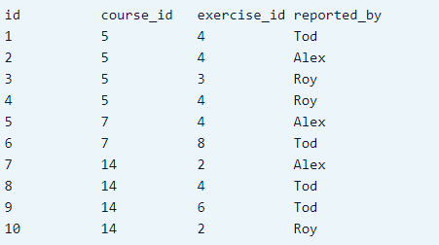
Use of DISTINCT
Let’s assume that in the database there is a table bugs which stores information about opened bug reports.
It might have columns like course_id, exercise_id, reported_by, reported_date, report_url, etc.
Notes:
Notice that there are several duplicates
To eliminate the duplicates, we use the DISTINCT keyword.
What if we dont want duplicates

Slide 34

Use of DISTINCT
DISTINCT in the SELECT clause, meaning that only distinct tuples should remain in the result.
Community Manager would like to know the names of the users who have reported bugs in order to send them a special Thank You note.
Query: SELECT DISTINCT reported_by FROM bugs;
Notes:
Notice that there are several duplicates
To eliminate the duplicates, we use the DISTINCT keyword.
What if we dont want duplicates

Slide 35
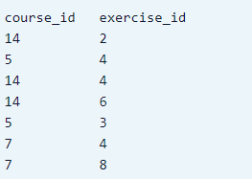
Exercise
Our coworker would like to know in which exercises bugs have been reported. Write a query to retrieve such data.
Notes:
SELECT DISTINCT course_id, exercise_id FROM bugs;
The keyword DISTINCT will simply remove duplicate results from the result set.

Slide 36
SELECT ALL
In general, a query with SELECT DISTINCT eliminates duplicates, whereas a query with SELECT ALL does not.
Specifying SELECT with neither ALL nor DISTINCT—as in our previous examples—is equivalent to SELECT ALL.
SELECT ALL Salary FROM EMPLOYEE;
retrieves the salary of every employee; if several employees have the same salary, that salary value will appear as many times in the result of the query,
SELECT DISTINCT Salary FROM EMPLOYEE;
If we are interested only in distinct salary values, regardless of how many employees earn that salary.

Slide 37
Tables as Sets in SQL
As we mentioned earlier, SQL usually treats a table not as a set but rather as a multiset; duplicate tuples can appear more than once in a table, and in the result of a query
SQL does not automatically eliminate duplicate tuples in the results of queries,
An SQL table with a key is restricted to being a set, since the key value must be distinct in each tuple.
Notes:
SQL does not automatically eliminate duplicate tuples in the results of queries, for the following reasons:
Duplicate elimination is an expensive operation. One way to implement it is to sort the tuples first and then eliminate duplicates.
The user may want to see duplicate tuples in the result of a query.
When an aggregate function is applied to tuples, in most cases we do not want to eliminate duplicates.

Slide 38
Tables as Sets in SQL
SQL has directly incorporated some of the set operations from mathematical set theory, which are also part of relational algebra
There are set union (UNION), set difference (EXCEPT), and set intersection (INTERSECT) operations.
These set operations apply only to type compatible relations, so we must make sure that the two relations on which we apply the operation have the same attributes and that the attributes appear in the same order in both relations.

Slide 39
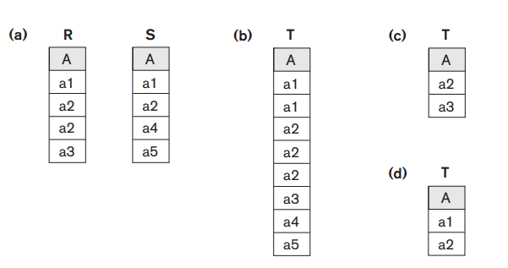
Tables as Sets in SQL
union
Difference
intersection

Slide 40
Pattern Matching
SQL has two special pattern-matching symbols used with LIKE comparison operator:
The % percent character represents any sequence of zero or more characters (wildcard).
The _ underscore character represents any single character.

Slide 41
Pattern Matching
Examples:
address LIKE ‘H%’ means the first character must be H, but the rest of the string can be anything.
address LIKE ‘H_ _ _’ means that there must be exactly four characters in the string, the first of which must be an H.
address LIKE ‘%e’ means any sequence of characters, of length at least 1, with the last character an e.
address LIKE ‘%Glasgow%’ means a sequence of characters of any length containing Glasgow.
Notes:
address NOT LIKE ‘H%’ means the first character cannot be an H

Slide 42
Pattern Matching
If the search string can include the pattern-matching character itself, we can use an escape character to represent the pattern-matching character.
Example, to check for the string ‘15%’, we can use:
LIKE ‘15#%’ ESCAPE ‘#’
Question: Find all owners with the string ‘Glasgow’ in their address
SELECT ownerNo, fName, IName, address, telNo FROM PrivateOwner WHERE address LIKE ‘%Glasgow%’;
Notes:
Also, we need a rule to specify apostrophes or single quotation marks (‘ ’) if they are to be included in a string because they are used to begin and end strings.
If an apostrophe (’) is needed, it is represented as two consecutive apostrophes (”) so that it will not be interpreted as ending the string.
select * from emp where percent LIKE '%#%' ESCAPE '#';
select * from emp;

Slide 43
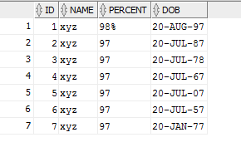
Exercise
Q: To retrieve all employees who were born during the 1970s
Notes:
select * from emp where DOB LIKE '__-___-7_';
select dob from emp where to_char(dob,'yyyy') like '197_';
select dob from emp where extract(year from dob) like '197_' ;

Slide 44
Calculated Fields
Another feature allows the use of arithmetic in queries.
The standard arithmetic operators for addition (+), subtraction (−), multiplication (*), and division (/) can be applied to numeric values or attributes with numeric domains.
In general, to use a calculated field, you specify an SQL expression in the SELECT list.
Calculated field sometimes called a computed or derived field such as age from bdate column can be calculated

Slide 45
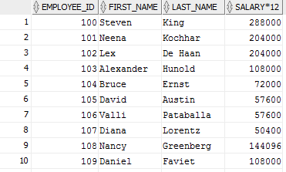
Calculated Fields
Produce a list of annual salaries for all employees, showing the employee_id, the first and last names, and the annual salaries.
select employee_id, first_name, last_name, salary * 12 from employees;

Slide 46
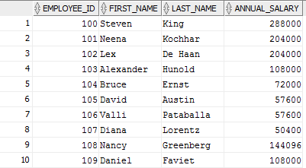
Calculated Fields
Produce a list of annual salaries for all employees, showing the employee_id, the first and last names, and the annual salaries.
select employee_id, first_name, last_name, salary * 12 AS annual_salary from employees;

Slide 47
Calculated Fields
For string data types, the concatenate operator || can be used in a query to append two string values.
For date, time, timestamp, and interval data types, operators include incrementing (+) or decrementing (−) a date, time, or timestamp by an interval.
In addition, an interval value is the result of the difference between two date, time, or timestamp values.

Slide 48
BETWEEN
Another comparison operator, which can be used for convenience, is BETWEEN
Q: Retrieve all employees in department 5 whose salary is between $30,000 and $40,000.
SELECT * FROM EMPLOYEE
WHERE (Salary BETWEEN 30000 AND 40000) AND Dno = 5;

Slide 49
Ordering of Query Results
SQL allows the user to order the tuples in the result of a query by the values of one or more of the attributes that appear in the query result, by using the ORDER BY clause.
SELECT column1, column2, ...
FROM table_name
ORDER BY column1, column2, ... ASC|DESC;
Example:
SELECT * FROM Customers ORDER BY Country;

Slide 50
INSERT COMMAND
used to add a single tuple (row) to a relation (table).
Syntax:
INSERT INTO table_name (column1, column2, column3, ...)
VALUES (value1, value2, value3, ...);
Example
INSERT INTO EMPLOYEE VALUES ( ‘Richard’, ‘K’, ‘Marini’, ‘653298653’, ‘1962-12-30’, ‘98 Oak Forest, Katy, TX’, ‘M’, 37000, ‘653298653’, 4 );
Note: The values should be listed in the same order in which the corresponding attributes were specified in the CREATE TABLE command.

Slide 51
INSERT COMMAND
Insert Data Only in Specified Columns
A second form of the INSERT statement allows the user to specify explicit attribute names that correspond to the values provided in the INSERT command.
INSERT INTO EMPLOYEE (Fname, Lname, Dno, Ssn) VALUES (‘Richard’, ‘Marini’, 4, ‘653298653’);
However, the values must include all attributes with NOT NULL specification and no default value.

Slide 52
INSERT COMMAND
Insert multiple tuples
It is also possible to insert into a relation multiple tuples separated by commas in a single INSERT command.
The attribute values forming each tuple are enclosed in parentheses.
Syntax
INSERT INTO MyTable ( Column1, Column2 )
VALUES ( Value1, Value2 ), ( Value1, Value2 );

Slide 53
INSERT COMMAND
INSERT INTO SELECT Statement
The INSERT INTO SELECT statement copies data from one table and inserts it into another table.
The INSERT INTO SELECT statement requires that the data types in source and target tables matches.
Note: The existing records in the target table are unaffected.
Syntax:
INSERT INTO table2 (column1, column2, column3, ...)
SELECT column1, column2, column3, ...
FROM table1
WHERE condition;
Example:
INSERT INTO Customers (CustomerName, City, Country)
SELECT SupplierName, City, Country FROM Suppliers;

Slide 54
INSERT COMMAND
Another variation for loading data is to create a new table that has the same attributes as an existing table T, and load some of the data currently in T into TNEW. The syntax for doing this uses the LIKE clause
Example:
CREATE TABLE D5EMPS LIKE EMPLOYEE (SELECT E.* FROM EMPLOYEE AS E WHERE E.Dno = 5) WITH DATA;
Notes:
Most DBMSs have bulk loading tools that allow a user to load formatted data from a file into a table without having to write a large number of INSERT commands.
The user can also write a program to read each record in the file, format it as a row in the table, and insert it using the looping constructs of a programming language

Slide 55
DELETE COMMAND
removes tuples from a relation.
includes a WHERE clause, similar to that used in an SQL query, to select the tuples to be deleted.
Tuples are explicitly deleted from only one table at a time.
However, the deletion may propagate to tuples in other relations if referential triggered actions are specified in the referential integrity constraints of the DDL
Example
DELETE FROM EMPLOYEE WHERE Lname = ‘Brown’;

Slide 56
UPDATE Command
used to modify attribute values of one or more selected tuples.
a WHERE clause in the UPDATE selects the tuples to be modified.
However, updating a primary key value may propagate to the foreign key values of tuples in other relations (ON UPDATE CASECASE)
An additional SET clause in the UPDATE command specifies the attributes to be modified and their new values.
Example
UPDATE PROJECT SET Plocation = ‘Bellaire’, Dnum = 5 WHERE Pnumber = 10;
Several tuples can be modified with a single UPDATE command
UPDATE EMPLOYEE SET Salary = Salary * 1.1 WHERE Dno = 5;

Slide 57
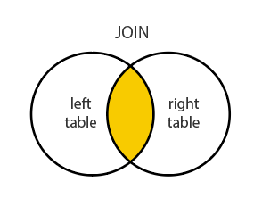
JOIN
SQL JOIN query combines records/rows from two tables.
A JOIN locates related column values in the two tables.
A query can contain zero, one, or multiple JOIN operations.

Slide 58
HR schema
Employees
employee_id | First_name | Last_name | email | phone_number | hire_date | salary | commission_pct | manager_id | department_id
Departments
department_id | department_name | manager_id | location_id
Locations
location_id | Street_addrress | postal_code | city | state_province

Slide 59
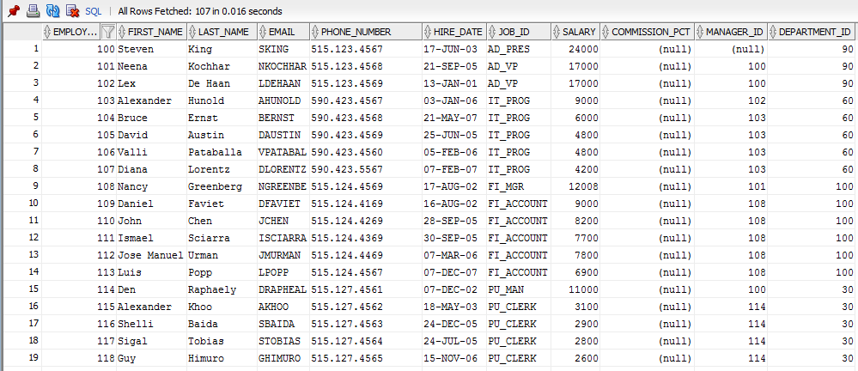
EMPLOYEES TABLE (HR USER)
Notes:
107 rows

Slide 60
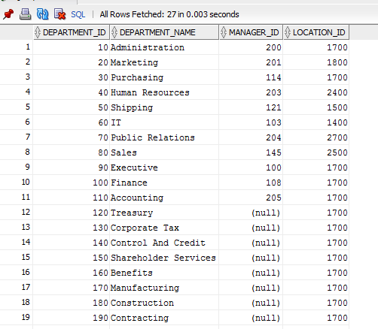
DEPARTMENTS TABLE (HR USER)
Notes:
27 ROWS

Slide 61
Query: Retrieve the department name of all the employees
SELECT employees.employee_id, employees.first_name, employees.last_name, departments.DEPARTMENT_NAME
FROM employees, departments
WHERE employees.department_id=departments.DEPARTMENT_ID
ORDER BY employees.EMPLOYEE_ID;
Notes:
is a list of attribute names whose values are to be retrieved by the query.
is a list of the relation names required to process the query.
is a conditional (Boolean) expression that identifies the tuples to be retrieved by the query
Each tuple in the result will be a combination of , one department, and one employee

Slide 62
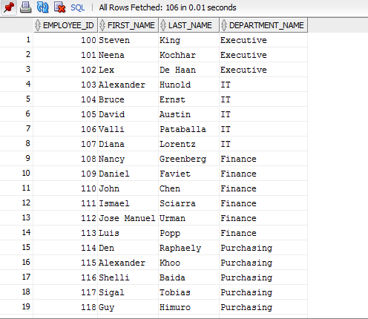
Query output
Notes:
106 rows???
Column with department no null is not retrieved.

Slide 63

Example 2
Retrieve the name and ID of all employees who work for the ‘Marketing’ department.
SELECT FIRST_NAME, LAST_NAME, Employee_id
FROM EMPLOYEES, DEPARTMENTS
WHERE Department_name= 'Marketing' AND EMPLOYEES.DEPARTMENT_ID = DEPARTMENTS.DEPARTMENT_ID;

Slide 64
Aliasing
alternative relation names
Example:
SELECT employee_id, E.first_name, E.last_name, D.DEPARTMENT_NAME
FROM employees E, departments D
WHERE E.department_id=D.DEPARTMENT_ID
ORDER BY E.EMPLOYEE_ID;

Slide 65
JOIN KEYWORD
alternative relation names
Example:
SELECT employee_id, E.first_name, E.last_name, D.DEPARTMENT_NAME
FROM employees E join departments D
On E.department_id=D.DEPARTMENT_ID
ORDER BY E.EMPLOYEE_ID;

Slide 66
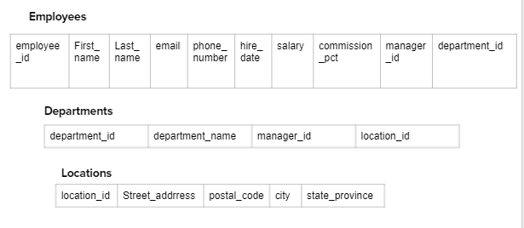
Exercise
Retrieve department name and street address of department of all the employees
Notes:
SELECT E.EMPLOYEE_ID, E.FIRST_NAME, E.DEPARTMENT_ID, D.DEPARTMENT_NAME, L.STREET_ADDRESS
FROM EMPLOYEES E, DEPARTMENTS D, LOCATIONS L
WHERE E.DEPARTMENT_ID=D.DEPARTMENT_ID AND D.LOCATION_ID=L.LOCATION_ID;

Slide 67
Renaming
It is also possible to rename the relation attributes within the query in SQL by giving them aliases.
For example, if we write
EMPLOYEE AS E(Fn, Mi, Ln, Ssn, Bd, Addr, Sex, Sal, Sssn, Dno)
in the FROM clause, Fn becomes an alias for Fname, Mi for Minit, Ln for Lname, and so on.

Slide 68
Guess the output
Q1: SELECT Ssn, Dname FROM EMPLOYEE, DEPARTMENT;
Notes:
It is extremely important to specify every selection and join condition in the WHERE clause; if any such condition is overlooked, incorrect and very large relations may result

Slide 69
SELECT STATEMENT
to retrieve and display data from one or more database tables
General form:
SELECT [DISTINCT | ALL] {* | [columnExpression [AS newName]] [, . . .]}
FROM TableName [alias] [, . . .]
[WHERE condition]
[GROUP BY columnList]
[HAVING condition]
[ORDER BY columnList]
represents a column name or an expression
specifies the table or tables to be used
filters the rows subject to some condition
forms groups of rows with the same column value
filters the groups subject to some condition
specifies the order of the output
Notes:
The sequence of processing in a SELECT statement is:
FROM specifies the table or tables to be used
WHERE filters the rows subject to some condition
GROUP BY forms groups of rows with the same column value
HAVING filters the groups subject to some condition
ORDER BY specifies the order of the output
FROM clause
ON clause
OUTER clause
WHERE clause
GROUP BY clause
HAVING clause
SELECT clause
DISTINCT clause
ORDER BY clause
TOP clause

